Slide 1

Communication strategy for a Fondazione Cariplo Project
The template
18th June 2021
Grant Office
Direzione Servizi per la Ricerca, Università degli Studi di Milano

Slide 2

Grant Office
Direzione Servizi per la Ricerca
officina.h2020@unimi.it
Skype: officina.h2020
Settore Progettazione della ricerca | Chiara Rengo | 02 503 12759
Ufficio PE-SH | Laura Sangalli | 02 503 12773
PE | Davide Bellavite | 02 503 12781
 | Giulia Rossignolo | 02 503 12771
SH | Deborah De Luca | 02 503 12737
 | Carolina Greco | 02 503 12846
 | Tomaso Perani | 02 503 12776
Ufficio LS | Vittoria Mastromauro | 02 503 12753
LS | Alice Barbaglio | 02 503 12707
 | Luca Corno | 02 503
 | Livio Mallia | 02 503 12766
 | Roberta Palorini | 02 503

Slide 3

Why do I need to
communicate my research?

Slide 4
Why communicate my research?
Communication activites are mandatory according to the grant agreements you sign with any funding agency (European Charter of Researchers).
They also maximise the impact of your project allowing your research to become more effective.
Internal and external communication might prove to be vital for the correct implementation of your research.
Allows you to give something back to your community
https://www.iprhelpdesk.eu/sites/default/files/EU-IPR-Brochure-Boosting-Impact-C-D-E_0.pdf

Slide 5
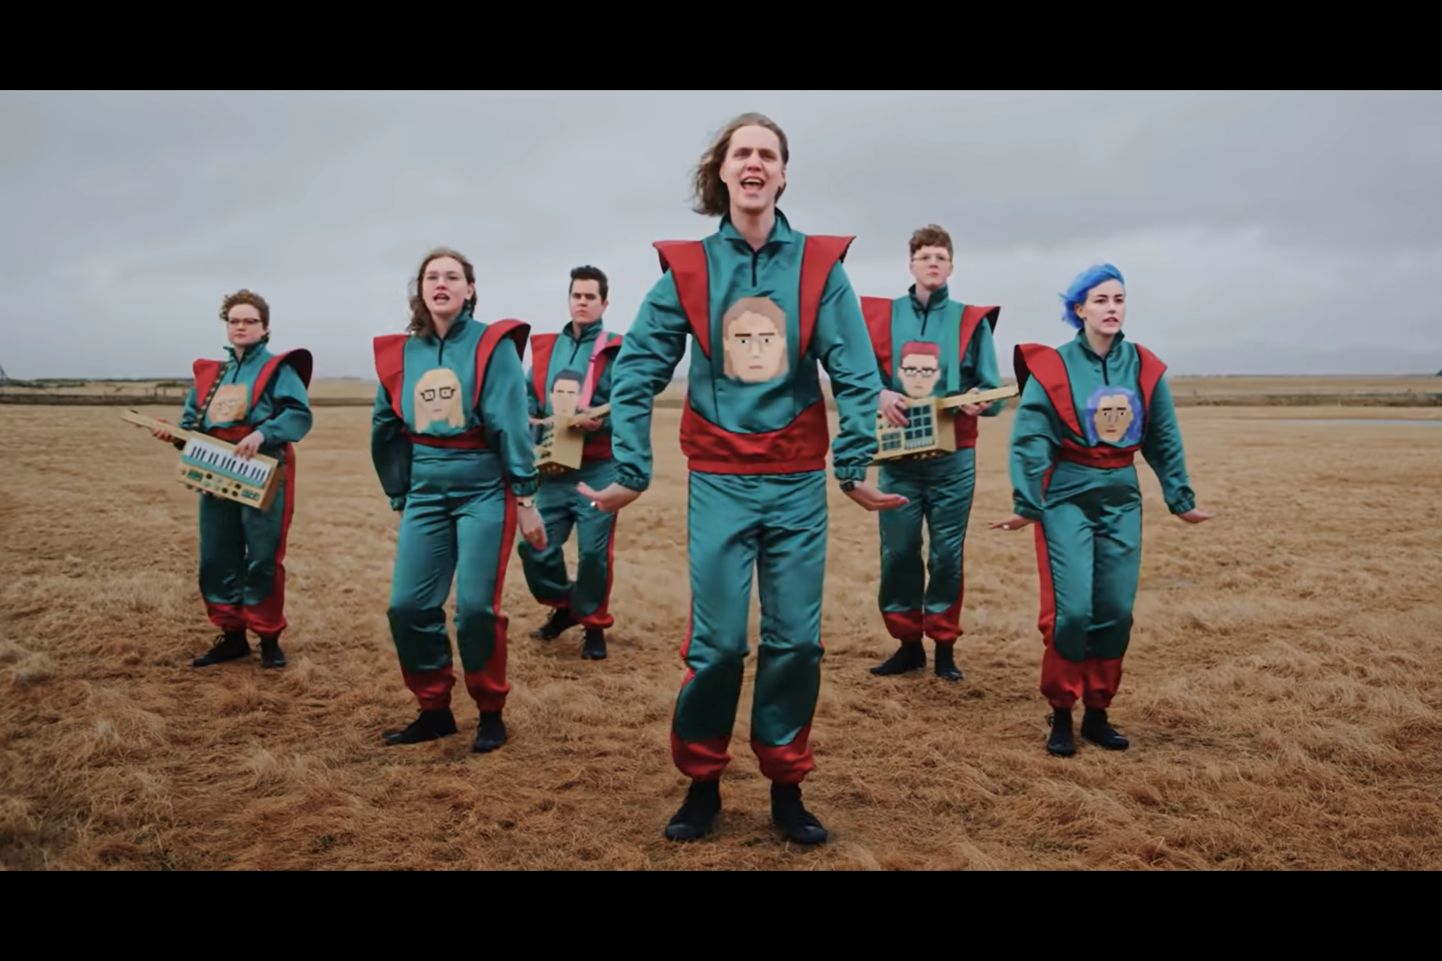
Why communicate my research?
It improves the quality of your research
HOW DOES IT KEEP GETTING BETTER?

Slide 6
The European Charter of Researchers
The European Charter for Researchers is a set of general principles and requirements which specifies the roles, responsibilities and entitlements of researchers as well as of employers and/or funders of researchers
https://euraxess.ec.europa.eu/sites/default/files/am509774cee_en_e4.pdf

Slide 7
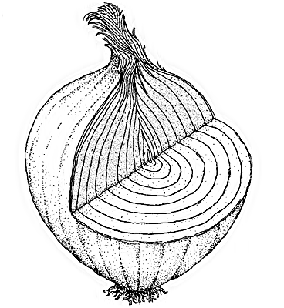
Focus on 12 aspects of research life.
Research Freedom
Ethical principles
Professional responsibility
Professional attitude
Contractual and legal obligations
Accountability
Good practice in research
Dissemination, exploitation of results
Public engagement
Relation with supervisors
Supervision and managerial duties
Continuing Professional Development

Slide 8


What is what… definitions

Slide 9
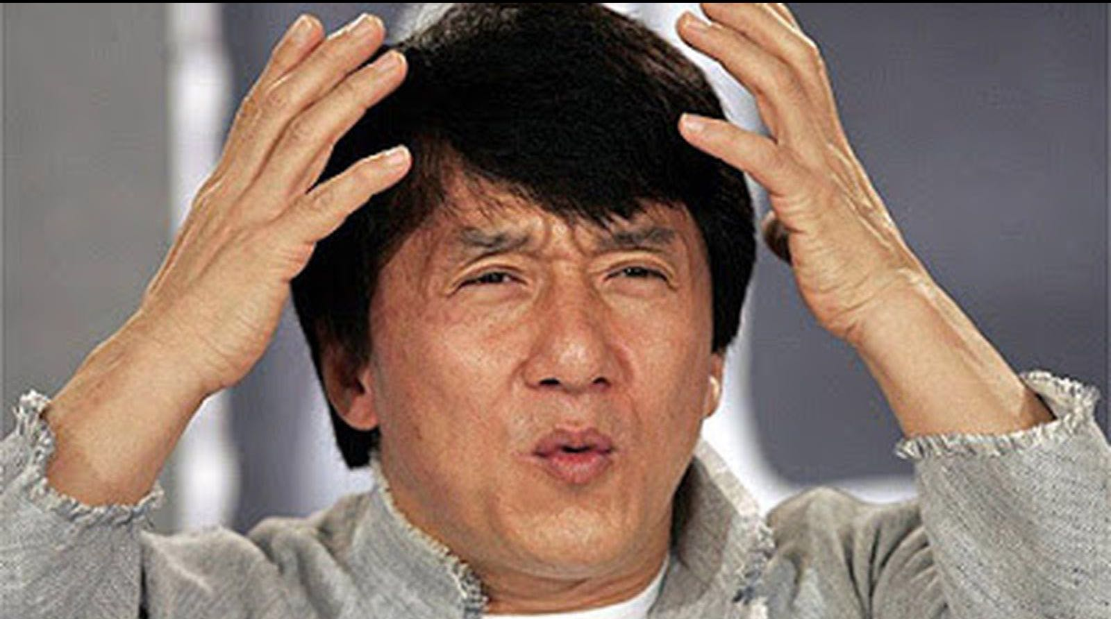
Communication? Dissemination?

Slide 10
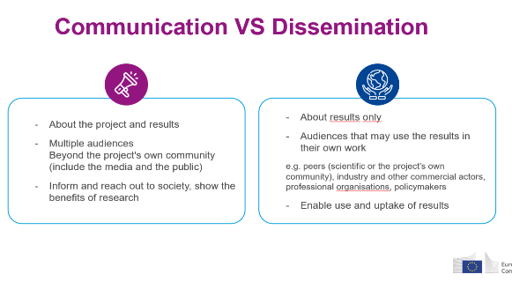
Communication vs Dissemination

Slide 11
Communication and Dissemination
COMMUNICATION
DISSEMINATION

Slide 12

Internal communication: duh!
In order to keep all this pieces together open, effective and continuous internal communication is vital!
It is quite a simple process but it is frequentely underestimated
Nothing happens by chance! You need to plan ahead!

Slide 13

Research Communication: Take home message
Communication of science is a key part of your job as a researcher
Officina H2020

Slide 14
Modern day mania?

Slide 15
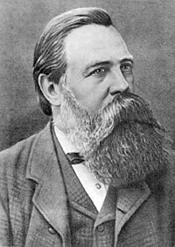
Now, we were by no means of the opinion that the new scientific results should be confided in large tomes exclusively to the “learned” world. Quite the contrary.
Frederick Engels, 1885

Slide 16
The Cariplo template

Slide 17
New
The Cariplo template

Slide 18
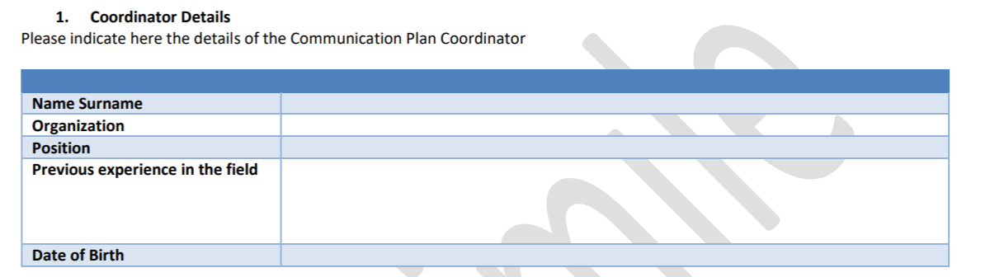
Coordinator:
Possibly a young researcher
In charge of the coordination of communication and dissemination activities
Is a key person in the project
Experience can be gained through specific trainig

Slide 19
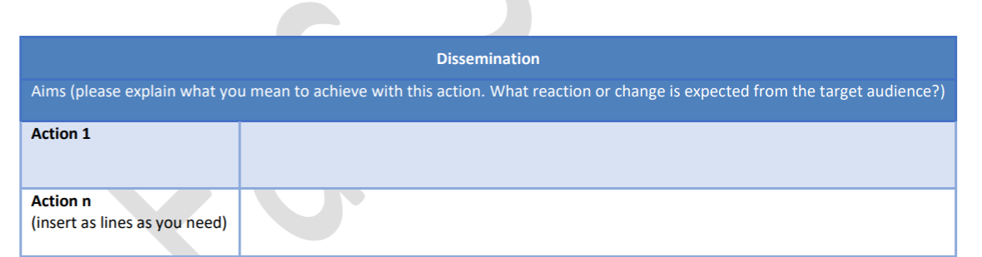
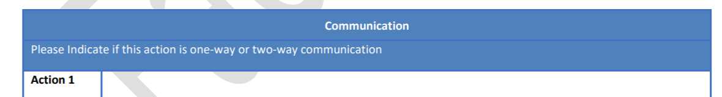
New structure!
The new form finally takes into account the difference between Dissemination and Communication
It is divided into «Actions» and you can add as many as you like.
TIP: Name the actions.
Action 1 (Scientific Papers) it is better than Action 1

Slide 20

New structure!
The sole difference between the dissemination and the communication sections is the «One way, two way» section.
Cariplo likes two-way communication actions because they allow you to better engage with the public and give you direct feedback

Slide 21

Aims
Define the aim form each action
Such aims are different from the scientific aims of your project
Aims should be SMART (Specific, Measurable, Achievable, Relevant, Time-bound)

Slide 22
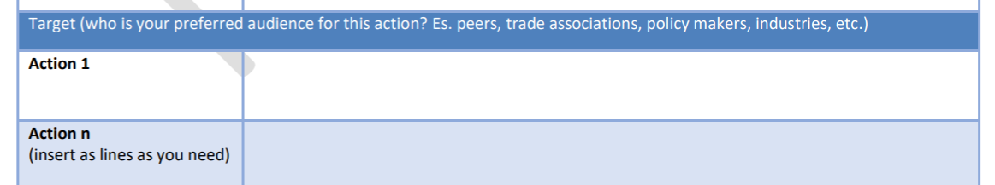
Targets
Targets are the people you want to engage in your communication/dissemination activities
Define them carefully: this might take time.
They are not just the people you talk to: they are the people you talk with.
Activities should be tailored on the target

Slide 23
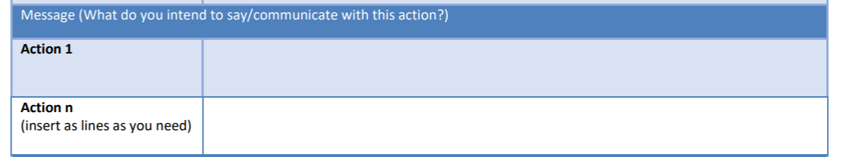
Message
Message is the key aspect of communication strategy
What do you what your target to know?
In what way it serves the aim of your communication acritivity?

Slide 24
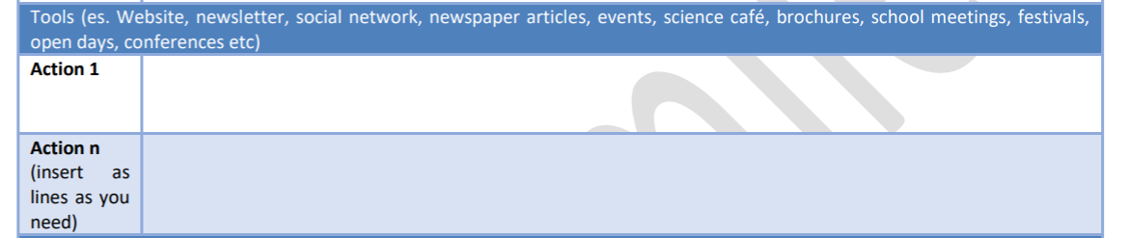
Tools
Which means of communication are you going to use?
Do they match the target audience?
Are they in line with the aims you set?

Slide 25
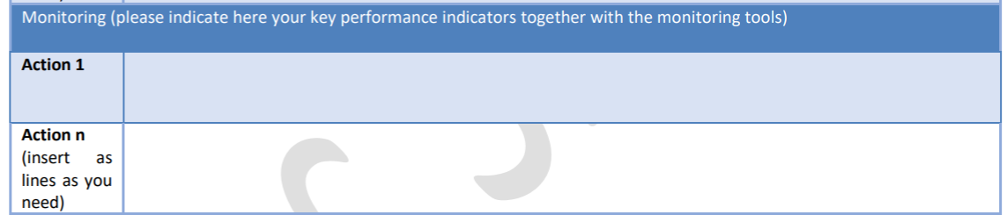
Monitoring
Monitor is a vital part of a communication strategy
Evaluation i easier if you have set SMART aims
Choose significant indicators
Choose indicators that are within your control

Slide 26
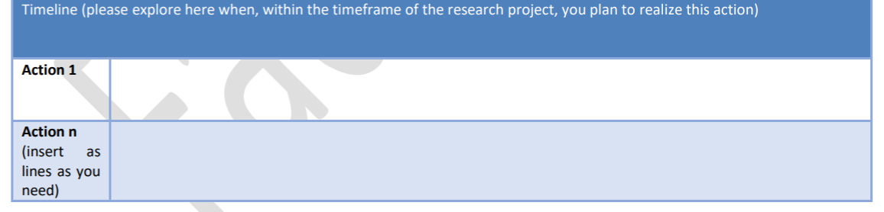
Timeline:
All your activities need to fall within the life of your project
Start from the beginning
Distribute them wisely and according to the project’s needs
Maybe a table (Gantt chart) and/or a narrative.

Slide 27
What do I need to communicate my research?
Do I need just a series of actions or do I need…

Slide 28
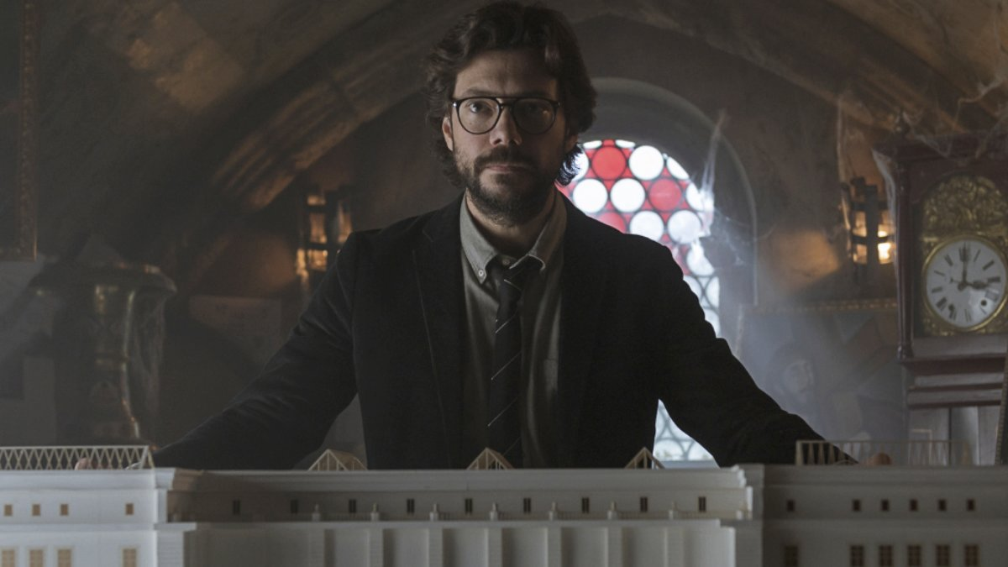
A strategy!

Slide 29
A strategy!
In communication…
A solid plan allow your piece of information to reach a relevant target in a significant significant way

Slide 30
A strategy!
In communication…
A solid plan allow your piece of information to reach a relevant target in a significant way

Slide 31
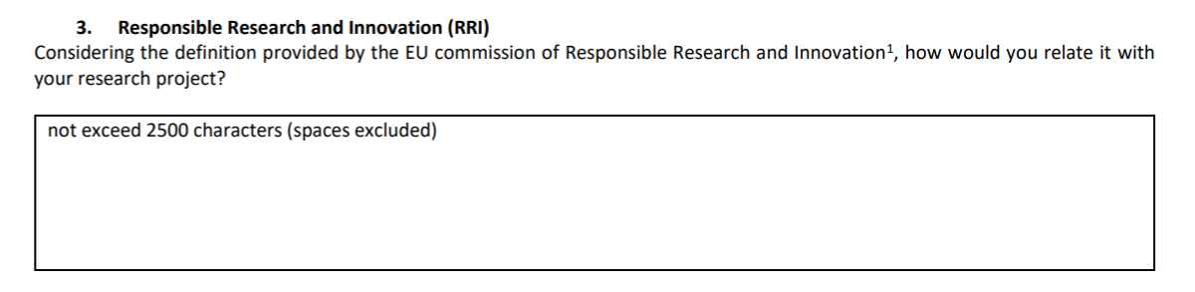
Responsible Research and Innovation:
Responsible Research and Innovation (RRI) implies that societal actors (researchers, citizens, policy makers, business, third sector organisations, etc.) work together during the whole research and innovation process in order to better align both the process and its outcomes with the values, needs and expectations of society.
https://ec.europa.eu/programmes/horizon2020/en/h2020-section/responsible-research-innovation

Slide 32
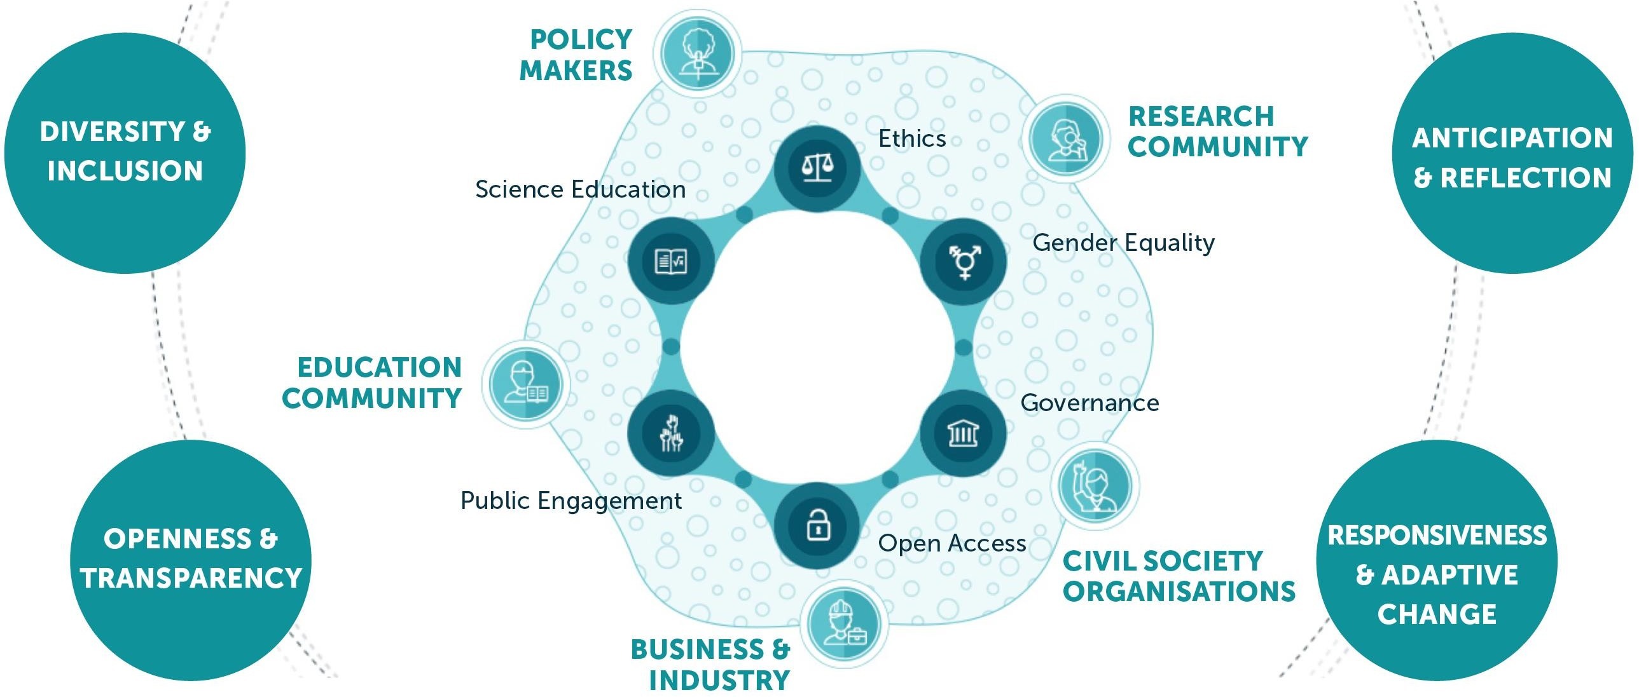
The RRI landscape
RRI

Slide 33

The 6 pillars of the RRI
In practice, RRI consists of designing and implementing R&I policy
that will:
engage society more broadly in its research and innovation activities,
increase access to scientific results,
ensure gender equality, in both the research process and research content,
take into account the ethical dimension, and
promote formal and informal science education.
http://ec.europa.eu/programmes/horizon2020/en/h2020-section/science-and-society

Slide 34
The 6 pillars of the RRI
ETHICS
GENDER EQUALITY
OPEN ACCESS
GOVERNANCE
PUBLIC ENGAGEMENT
SCIENCE EDUCATION
12

Slide 35
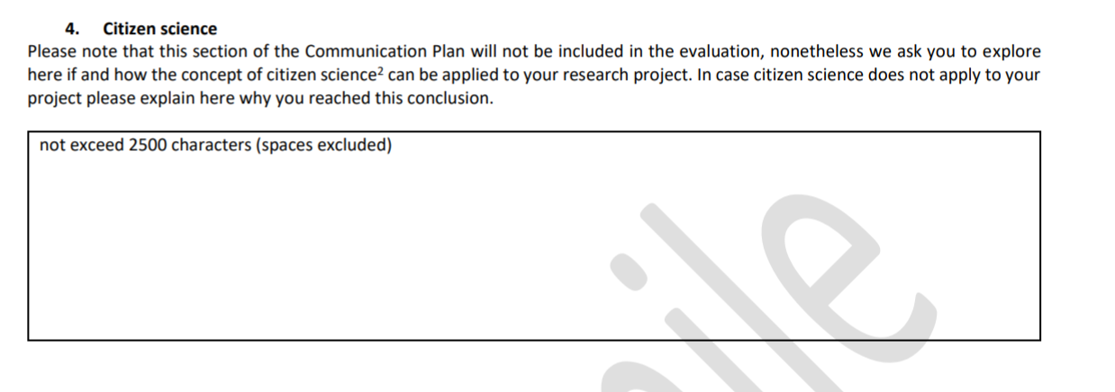
Citizen Science: new feature
https://eu-citizen.science/
https://www.zooniverse.org/

Slide 36

Citizen Science: new feature
CITIZEN SCIENCE AS A RESEARCH TOOL AND SCIENTIFIC APPROACH

Slide 37
Citizen Science: new feature
5 Cs classification
Contractual-communities ask professional researchers to conduct a specific scientific investigation and report on the results;
Contributory-generally designed by scientists and members of the public primarily contribute data;
Collaborative-generally designed by scientists and members of the public contribute data, refine project design, analyse data, disseminate findings;
Co-Created -designed by scientists and members of the public working together, some of the public participants are actively involved in most aspects of the research process; and
Collegial-non-credentialed individuals conduct research independently with varying degrees of expected recognition by institutionalised science.
Shirk et al. (2012). Public participation in scientific research: a framework for deliberate design. Ecology and Society, 17(2).

Slide 38
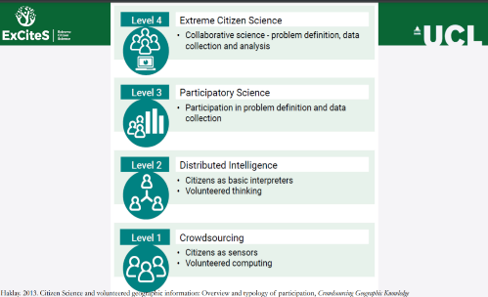
Citizen Science: new feature

Slide 39
General rules
Be specific
Be clear
Be coherent
Have fun

Slide 40
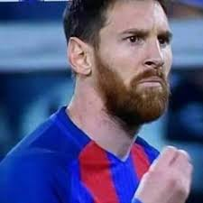
Is there something missing?

Slide 41
The budget!!!
In order to carry out all your communication activities you need to carefully budget all your needs and ideas

Slide 42
Take home message:
Communication of science is a key part of your job as a researcher

Slide 43

Thank you

